Slide 1



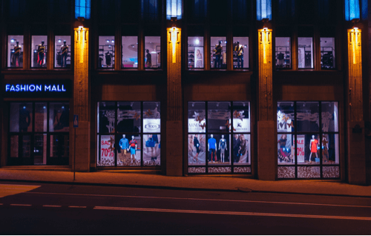

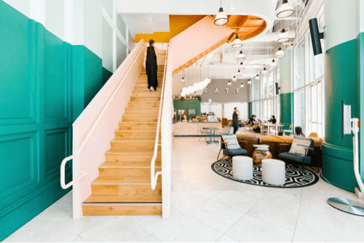



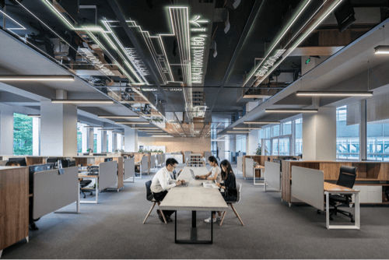



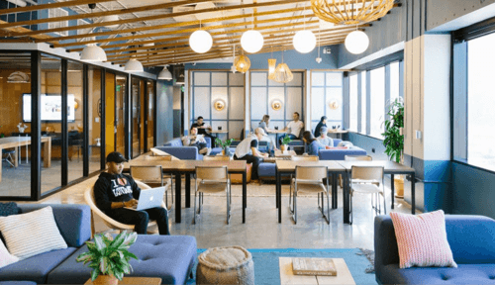

E-GOV INTERMEDIARIES
Developed By:
DEVANG SHARMA
devangs@cisco.com

Slide 2

TABLE OF CONTENTS
BACKGROUND
PRODUCT OVERVIEW
01
04
WHAT ARE INTERMEDIARIES?
PROJECT TIMELINE
02
05
CONTEXT
CONTACT US
03
06

Slide 3

BACKGROUND
Many Urban Citizen Services such as applying for Water Connection, Trade Licenses, Registering grievances are available through the Physical Channels such as Department offices, Citizen Service Centres and through Digital Channels such as Portal, Mobile etc. While the Digital adoption and e-governance initiatives are seeing an uptake, the contribution of Digital Channels (Portal, Mobiles) are still around 20% in some of the biggest cities in the country.

Slide 4


PROJECT TIMELINE
FEB 2021
MAR-APR 2021
LIVE DEMO AVAILABLE
DEPLOYMENT AFTER TESTING

Slide 5
WHAT ARE INTERMEDIARIES?
Intermediaries are individuals or organizations that undertake the role of mediators or linkage between two parties. Intermediaries are third parties and fill a function that is needed by two other parties to make a deal or to execute a given task.

Slide 6
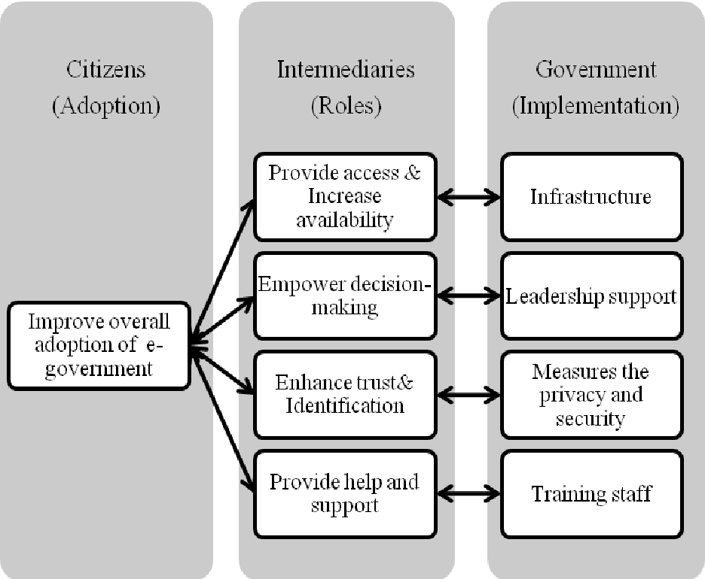
ROLE OF INTERMEDIARIEs

Slide 7
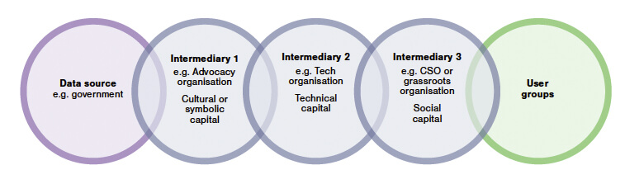
PERFORMANCE
AGAINST SCHEDULE
Milestone | Scheduled Completion Date | Actual Completion Date | Difference
Milestone Name | 10/04 | 10/05 | 1 Day Late
Milestone Name | 04/21 | 04/21 | On Time
Milestone Name | 01/13 | 01/09 | 4 Days Early
Milestone Name | 04/24 | 03/13 | 6 Weeks Early
Milestone Name | 05/25 | 05/30 | 5 Days Late
Milestone Name | 09/22 | 09/23 | 1 Day Late
Project Completion | 12/04 | 12/11 | 1 Week Late

Slide 8
CONTEXt
On the eGov DIGIT platform, many citizen services are enabled in the self serve mode (Portal, Mobile, WhatsApp).
During one of the field studies done to understand this question of access better, it came to light that there were many informal channels – which the citizens used to connect with the government for their needs.
The local leaders (Thalaivas), the non-profits working on specific causes, the local educated (digitally aware and socially conscious) volunteers formed an important channel to funnel the needs of citizens and facilitated the dealing with the government department and sometimes facilitated door step delivery of services.

Slide 9
HOW INTERMEDIARIES HELP?
These intermediaries approach this in multiple ways – through their existing social connections, formal campaigns, volunteering and in some cases even formalized with the blessing from the department.
NGOs such as Reap benefit, Sanjhi Sikhiya are few who use Youth volunteerism to take up local issues and try to provide solutions. These organizations often try to solve some of the access problems to government services.
There are other Formal channels with departmental approval which focuses on doorstep delivery of services such as (Delhi government program, AP’s Ward Secretariat programs) albeit in different models
In some cases, small entrepreneurs open shop with digital access to various government services and help local citizens to avail such services without having to visit government offices – they may charge a fee for the services they provide. E.g. AP Online
Caste and community based associations who are immersed in areas, working on specific issues also provide such access in the course of delivering their community work.
Local politicians and party works are also involved in facilitating such governmental interface
Because of these, intermediaries (Or assisted channels) are seen as a significant enabler to access government services.

Slide 10

BIG GOAL
BIG GOAL
BIG GOAL
Brief Description of this goal
Brief Description of this goal
Brief Description of this goal
BIG GOAL
BIG GOAL
Brief Description of this goal
Brief Description of this goal
BIG GOAL
Brief Description of this goal

Slide 11
PRODUCT OBJECTIVES
Mailers
Email
Social Media
LinkedIn
Facebook
Why do citizens need intermediaries for these services?
Who are the intermediaries?
How does your proposed product/solution integrate with any/all of the products on the DIGIT stack?
What is the business model for this intermediation - will intermediaries charge for this service? Is this something that should only be done free of charge?
Banner Ads
TV Ads

Slide 12

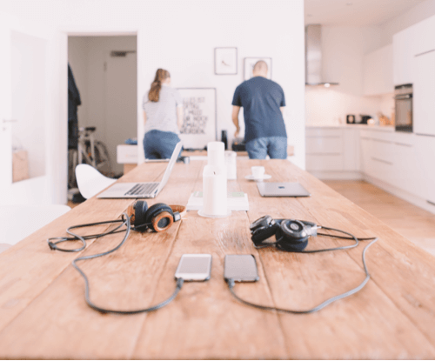

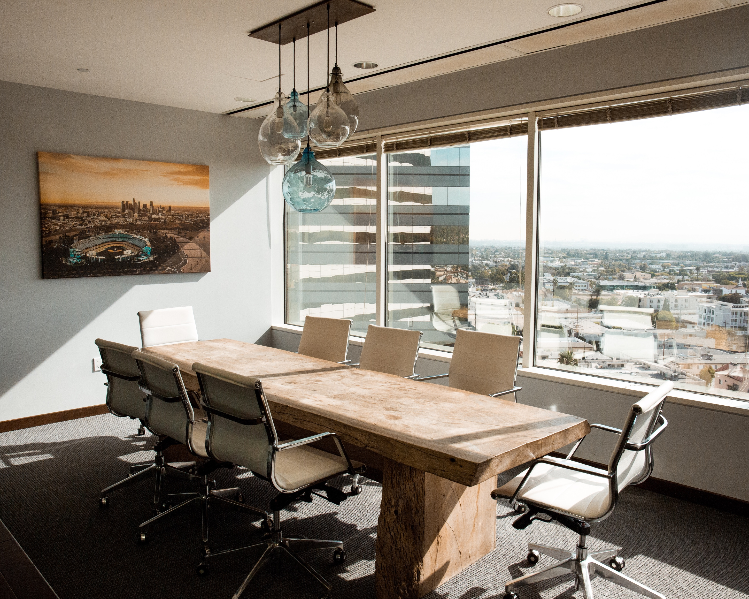
NEXT STEPS
Step Three
Step One
Step Two
Working Protoptype for E-GOV Intermediaries
Step Four
Step Five
Clarified Product Requirements and Analysis
Developed Prototype With Required Specifications
Testing and Deployment using DIGIT Tech Stacck
Serve the Website to the Public Users

Slide 13

SOURCE CODE
GITHUB
Leave your audience with a quick final thought that encapsulates you, your company, or this presentation.
Phone | +91-9953027469
Email | devangs@cisco.com

Slide 14


MEET THE TEAM
DEVANG SHARMA
Senior Software Developer At CISCO
devangs@cisco.com
Linkedin: https://www.linkedin.com/in/devang25/

Slide 15
CONTACT
US
PARTING THOUGHTS
Leave your audience with a quick final thought that encapsulates you, your company, or this presentation.
Website | www.company.com
Phone | +123 456 789 101
Email |name@company.com

